Slide 1
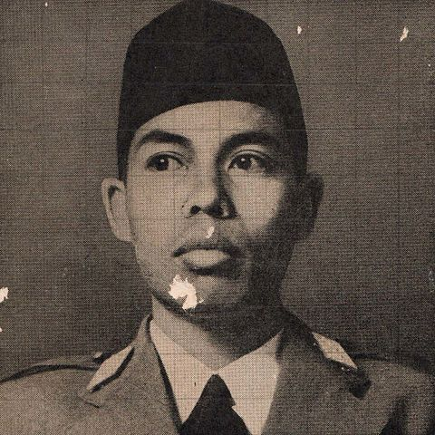
Learning objectives
At the end of the learning process, the students have to be able to : 1. identify the function and the formula of simple present tense 2. create some sentences using simple present tense 3. produce a daily activities using simple present tense 4. use simple present tense in the daily life

Slide 2
Descriptive Text
Created by : Finka Ayu Fitriani, S.Pd

Slide 3
Learning objectives
At the end of the learning process, the students have to be able to : 1. identify the social function, text structure and language features of descriptive text 2. analyse the social function, text structure and language features of descriptive text 3. create a descriptive text using appropriate structure and language features 4. present a descriptive text using appropriate structure and language features

Slide 4
Borobudur temple is one of the most beautiful tourist resorts in Indonesia. It is located in central Java, Indonesia. Borobudur temple is one of the seven wonders of the world which needs to be preserved its circumstances. The people all over the world know that Borobudur is one of the greatest art works that ever known since long time ago. Borobudur temple was built by Syailendra Dynasty during the eighth century. It needed more than two million river stones. It is the biggest temple in the world. After going into some restorations, Borobudur is visited by more and more tourists, both domestic and foreign tourists. Most of them admire Borobudur temple because of its beauty, its elegance and the story of the relief on its walls. Domestic tourists usually go there by bus or private cars, while foreign tourists like to join travel bureau because they don’t need to think of the transportation, accommodation, and itinerary. There are some money changers around the location. It makes them easier to change their money. But some of them like to bring credit cards and checks.
Borobudur Temple

Slide 5
Definition & Social Function

Slide 6
Borobudur temple is one of the most beautiful tourist resorts in Indonesia. It is located in central Java, Indonesia. Borobudur temple is one of the seven wonders of the world which needs to be preserved its circumstances. The people all over the world know that Borobudur is one of the greatest art works that ever known since long time ago. Borobudur temple was built by Syailendra Dynasty during the eighth century. It needed more than two million river stones. It is the biggest temple in the world. After going into some restorations, Borobudur is visited by more and more tourists, both domestic and foreign tourists. Most of them admire Borobudur temple because of its beauty, its elegance and the story of the relief on its walls. Domestic tourists usually go there by bus or private cars, while foreign tourists like to join travel bureau because they don’t need to think of the transportation, accommodation, and itinerary. There are some money changers around the location. It makes them easier to change their money. But some of them like to bring credit cards and checks.
Borobudur Temple

Slide 7
Text Structure

Slide 8
Borobudur temple is one of the most beautiful tourist resorts in Indonesia. It is located in central Java, Indonesia. Borobudur temple is one of the seven wonders of the world which needs to be preserved its circumstances. The people all over the world know that Borobudur is one of the greatest art works that ever known since long time ago. ---------- Identification Borobudur temple was built by Syailendra Dynasty during the eighth century. It needed more than two million river stones. It is the biggest temple in the world. ---------- Description After going into some restorations, Borobudur is visited by more and more tourists, both domestic and foreign tourists. Most of them admire Borobudur temple because of its beauty, its elegance and the story of the relief on its walls. ---------- Description Domestic tourists usually go there by bus or private cars, while foreign tourists like to join travel bureau because they don’t need to think of the transportation, accommodation, and itinerary. There are some money changers around the location. It makes them easier to change their money. But some of them like to bring credit cards and checks. ---------- Description
Borobudur Temple

Slide 9
Language Features

Slide 10
Borobudur temple is one of the most beautiful tourist resorts in Indonesia. It is located in central Java, Indonesia. Borobudur temple is one of the seven wonders of the world which needs to be preserved its circumstances. The people all over the world know that Borobudur is one of the greatest art works that ever known since long time ago. Borobudur temple was built by Syailendra Dynasty during the eighth century. It needed more than two million river stones. It is the biggest temple in the world. After going into some restorations, Borobudur is visited by more and more tourists, both domestic and foreign tourists. Most of them admire Borobudur temple because of its beauty, its elegance and the story of the relief on its walls. Domestic tourists usually go there by bus or private cars, while foreign tourists like to join travel bureau because they don’t need to think of the transportation, accommodation, and itinerary. There are some money changers around the location. It makes them easier to change their money. But some of them like to bring credit cards and checks.
Borobudur Temple

Slide 11
What is Descriptive Text What is the Purpose of Descriptive Text?

Slide 12
A descriptive text describes a particular object like a place, thing, or person.
What is the purpose of descriptive text?
The purpose of descriptive text is to describe the particular object by describing its or his/
her specific features to help readers visualize what a person, an animal, or a
thing is like.

Slide 13
What is the Text Structure of Descriptive Text?

Slide 14
Text Structure and Language Features
The text structure of descriptive text are :
Identification is to introduce the object.
Description gives the detail information of the object described.
Focus on specific participants
e.g: My Cat, Borobudur Temple, Kuta Beach
The use of noun/ noun phrase
e.g: At night, you can enjoy the clear sky and the bright stars.
The use of simple present tense
e.g: Tanjung Puting National Park offers an impressive experience.

Slide 15

Questions ?????

Slide 16
Exercise 1
Do the exercise at LMS !

Slide 17
Exercise 2

Slide 18
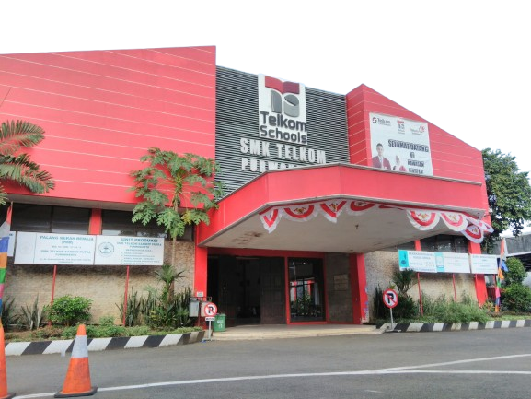
Create a descriptive text about your school by using approprite text structures and language features!

